Slide 1

Relationship between two continuous variables
EDUC 641: Week 6
Cengiz Zopluoglu

Slide 2
Goals
Visualize & describe relationships between two quantitative variables using scatterplots (shape, trend, strength).
Define and compute covariance, explain its properties (symmetry, relation to variance), and recognize unit dependence.
Define, compute, and interpret Pearson’s correlation as standardized covariance; compare magnitude, direction, and bounds (–1 to +1).
Test the significance of the correlation using the t-test; compute t-statistic, degrees of freedom, and interpret p-values.
Use R for correlation analysis: cor() and Hmisc :rcorr() functions Report a correlation matrix in APA style
Handle missing data in correlations via listwise vs. pairwise deletion, noting pros/cons and implications for sample size and comparability.

Slide 3
Covariance and Correlation

Slide 4
Historical Origin
Francis Galton (1822–1911) is widely credited with introducing the statistical concept of correlation in the late 19th century.
In his 1888 paper “Co-relations and their Measurement, chiefly from Anthropometric Data”, Galton used the term “co-relation or correlation of structure” and attempted to formally define and measure the degree to which two variables vary together.
Galton noted that the phrase co-relation was already used in biology but had not yet been formally defined or quantified.
The hyphenated co-relation appears in his 1888 paper; over time, it evolved into the modern spelling correlation.
Pearson Correlation
While Galton introduced and named the idea of co-relation, Karl Pearson formalized the product-moment correlation coefficient in 1896, building on Galton’s ideas and earlier mathematical work by French physicist Auguste Bravais.
The Pearson correlation coefficient (ρ) is now the most widely used measure of linear association between continuous variables.

Slide 5
Scatterplot
A scatterplot is a graphical tool used to visualize the relationship between two quantitative variables.
Each point represents a single observation, located according to its values on the two variables, forming (x, y) coordinates.
By convention, the predictor (independent variable) is placed on the x-axis, and the
outcome (dependent or criterion variable) on the y-axis.
Scatterplots help us visually assess:
Trend/Direction of the pattern Linearity vs. non-linearity Strength of association Outliers and unusual patterns
Possible clusters or heteroscedasticity
Example variables (2019):
Physicians per 1,000 inhabitants
Under-five mortality rate per 1,000 live births

Slide 6


country | doctor | infmor
Australia | 3.8 | 3.6
Austria | 5.3 | 3.5
Belgium | 3.2 | 3.4
Canada | 2.8 | 4.9
Czech Republic | 4.1 | 3.2
Estonia | 3.5 | 2.4
France | 3.4 | 4.5
Germany | 4.4 | 3.8
Hungary | 3.5 | 3.7
Iceland | 3.9 | 2
Ireland | 3.3 | 3.3
Israel | 3.3 | 3.7
Italy | 4 | 3.1
Korea | 2.5 | 3.2
Latvia | 3.3 | 3.6
Lithuania | 4.6 | 3.7
Mexico | 2.4 | 14.2
New Zealand | 3.4 | 4.7
Norway | 5 | 2.4
Slovak Republic | 3.6 | 5.8
Slovenia | 3.3 | 2.1
Spain | 4.4 | 3.1
Switzerland | 4.3 | 4
Turkey | 1.9 | 10
United Kingdom | 3 | 4.3
United States | 2.6 | 6.5
Imagine that we represent each country in a two-dimensional space using the pairs of values as X-Y coordinates.

Slide 7
country | doctor | infmor
Australia | 3.8 | 3.6
Austria | 5.3 | 3.5
Belgium | 3.2 | 3.4
Canada | 2.8 | 4.9
Czech Republic | 4.1 | 3.2
Estonia | 3.5 | 2.4
France | 3.4 | 4.5
Germany | 4.4 | 3.8
Hungary | 3.5 | 3.7
Iceland | 3.9 | 2
Ireland | 3.3 | 3.3
Israel | 3.3 | 3.7
Italy | 4 | 3.1
Korea | 2.5 | 3.2
Latvia | 3.3 | 3.6
Lithuania | 4.6 | 3.7
Mexico | 2.4 | 14.2
New Zealand | 3.4 | 4.7
Norway | 5 | 2.4
Slovak Republic | 3.6 | 5.8
Slovenia | 3.3 | 2.1
Spain | 4.4 | 3.1
Switzerland | 4.3 | 4
Turkey | 1.9 | 10
United Kingdom | 3 | 4.3
United States | 2.6 | 6.5

Slide 8
Describing the Pattern in a Scatterplot
When describing the relationship in a scatterplot, consider three features: shape, trend, and strength.
Shape: Describe the form of the relationship:
Linear
Curvilinear (e.g., quadratic, exponential) Clusters or subgroups
Outliers
Trend (Direction)
Positive trend: Higher values on one variable are associated with higher values on the other.
Negative trend: Higher values on one variable are associated with lower values
on the other.
No trend: No consistent direction in the relationship.
Strength
Strong: Points lie close to an imaginary line or curve.
Weak: Points are widely scattered.
Consider whether the strength is constant or changes across the range (e.g., heteroscedasticity).

Slide 9
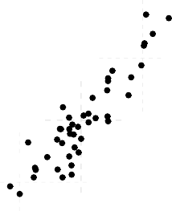
Shape:
Trend:
Strength:

Slide 10
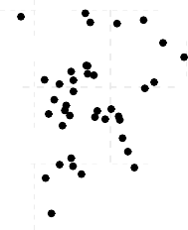
Shape:
Trend:
Strength:

Slide 11
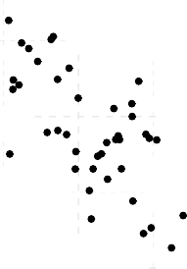
Shape:
Trend:
Strength:

Slide 12
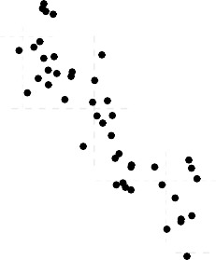
Shape:
Trend:
Strength:

Slide 13
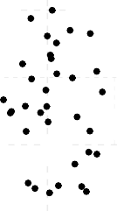
Shape:
Trend:
Strength:

Slide 14
Covariance
Covariance is a numerical measure of how two variables co-vary, or how they change together relative to their means.
If both variables tend to be above (or below) their means together, the covariance is positive.
If one tends to be above its mean when the other is below, the covariance is negative.
The sample covariance between (X) and (Y) is:
1
∑(X_{i} − X¯)(Y_{i} − Y¯)
Cov(X, Y ) =
N − 1
This quantity represents the average cross-product of deviations from the mean.

Slide 15
country | doctor | infmor
Australia | 3.8 | 3.6
Austria | 5.3 | 3.5
Belgium | 3.2 | 3.4
Canada | 2.8 | 4.9
Czech Republic | 4.1 | 3.2
Estonia | 3.5 | 2.4
France | 3.4 | 4.5
Germany | 4.4 | 3.8
Hungary | 3.5 | 3.7
Iceland | 3.9 | 2
Ireland | 3.3 | 3.3
Israel | 3.3 | 3.7
Italy | 4 | 3.1
Korea | 2.5 | 3.2
Latvia | 3.3 | 3.6
Lithuania | 4.6 | 3.7
Mexico | 2.4 | 14.2
New Zealand | 3.4 | 4.7
Norway | 5 | 2.4
Slovak Republic | 3.6 | 5.8
Slovenia | 3.3 | 2.1
Spain | 4.4 | 3.1
Switzerland | 4.3 | 4
Turkey | 1.9 | 10
United Kingdom | 3 | 4.3
United States | 2.6 | 6.5
Average | 3.57 | 4.33
X - X̄ | Y - Ȳ
0.23 | -0.73
1.73 | -0.83
-0.37 | -0.93
-0.77 | 0.57
0.53 | -1.13
-0.07 | -1.93
-0.17 | 0.17
0.83 | -0.53
-0.07 | -0.63
0.33 | -2.33
-0.27 | -1.03
-0.27 | -0.63
0.43 | -1.23
-1.07 | -1.13
-0.27 | -0.73
1.03 | -0.63
-1.17 | 9.87
-0.17 | 0.37
1.43 | -1.93
0.03 | 1.47
-0.27 | -2.23
0.83 | -1.23
0.73 | -0.33
-1.67 | 5.67
-0.57 | -0.03
-0.97 | 2.17
(X - X̄ )(Y - Ȳ)
-0.170
-1.445
0.345
-0.435
-0.602
0.134
-0.028
-0.444
0.044
-0.772
0.279
0.171
-0.532
1.213
0.198
-0.654
-11.535
-0.062
-2.768
0.045
0.602
-1.026
-0.245
-9.457
0.020
-2.099
1
N − 1
∑(X − X)(Y − Y ) =
−29.22 26 − 1
¯ ¯
= −1.17
i i

Slide 16
Basic Properties of Covariance
Symmetry
Cov(X, Y ) = Cov(Y , X)
Relationship to variance
Cov(X, X) = V ar(X)
Range
Covariance can take any value from (−∞, +∞).
Unit dependence
The magnitude of covariance depends on the units of X and Y , so it is not inherently interpretable without reference to their scales.
Interpretation
Positive covariance → variables increase/decrease together Negative covariance → variables move in opposite directions Zero → no linear relationship

Slide 17
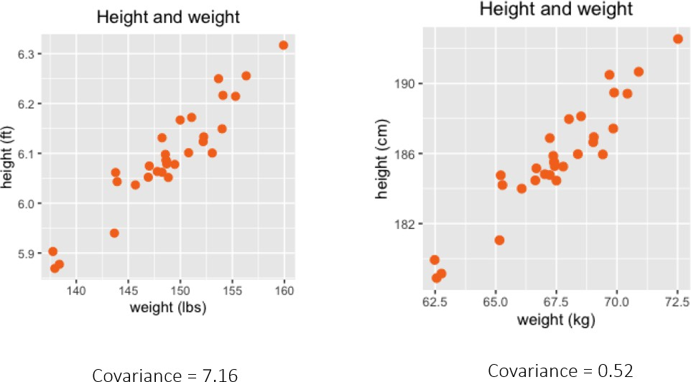
Suppose you are collaborating with a researcher in Europe and you each plot height and weight for the same 30 individuals, but using different units.
The covariance values differ even though the underlying data (the people measured) are identical.
This occurs because covariance is unit-dependent — it scales with the measurement units of the variables.
Therefore, covariance by itself is not standardized and not directly comparable across studies or contexts unless the variables are measured in the same units.
Covariance tells us only the direction of the relationship (positive or negative), not its magnitude on a common scale.

Slide 18
Correlation
¹ ∑(X_{i} − X¯)(Y_{i} − Y¯)
r =
N−1
σ^_{x}σ^_{y}
Correlation is a standardized form of covariance, obtained by dividing covariance by the product of the standard deviations of the two variables.
Because it removes the influence of measurement units, correlation is independent of the scale or metric of both variables.
The correlation coefficient ranges from –1 to +1:
+1: perfect positive linear association
-1: perfect negative linear association 0 : no linear association
Because correlation is unitless and bounded, it is easier to interpret than covariance.

Slide 19
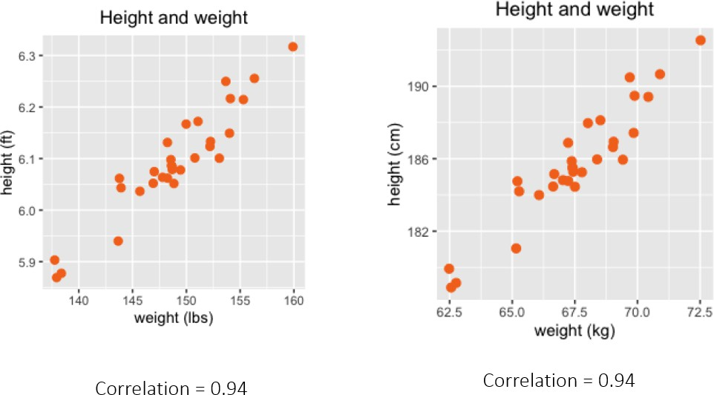

Slide 20
∑(X − X)(Y − Y ) =
1
−29.22
¯ ¯
= −1.17
LOCATION | doctor | infmor
Australia | 3.8 | 3.6
Austria | 5.3 | 3.5
Belgium | 3.2 | 3.4
Canada | 2.8 | 4.9
Czech Republic | 4.1 | 3.2
Estonia | 3.5 | 2.4
France | 3.4 | 4.5
Germany | 4.4 | 3.8
Hungary | 3.5 | 3.7
Iceland | 3.9 | 2
Ireland | 3.3 | 3.3
Israel | 3.3 | 3.7
Italy | 4 | 3.1
Korea | 2.5 | 3.2
Latvia | 3.3 | 3.6
Lithuania | 4.6 | 3.7
Mexico | 2.4 | 14.2
New Zealand | 3.4 | 4.7
Norway | 5 | 2.4
Slovak Republic | 3.6 | 5.8
Slovenia | 3.3 | 2.1
Spain | 4.4 | 3.1
Switzerland | 4.3 | 4
Turkey | 1.9 | 10
United Kingdom | 3 | 4.3
United States | 2.6 | 6.5
Average | 3.57 | 4.33
Standard Deviation | 0.81 | 2.57
N − 1
i i
26 − 1
¹ ∑(Xi − X¯)(Yi − Y¯)
−1.17
r =
N−1
σ^ σ^
⁼ 0.81 × 2.57 ^{= −0.563}
x y

Slide 21

https://www.guessthecorrelation.com/

Slide 22
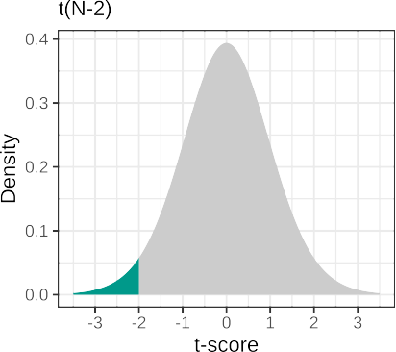
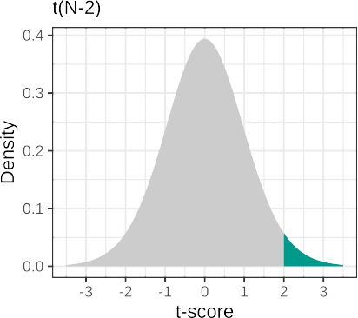
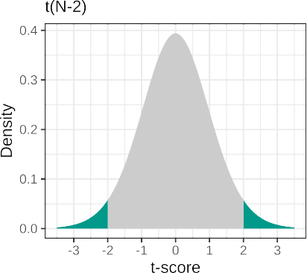
Statistical Inference for Correlation
We can test whether or not the correlation coefficient is significantly different than zero at the population level.
H₀ : ρ = 0
The sampling distribution of sample correlation is a t-distribution with N-2 degrees of freedom.
t = r × √
N−1 1−r²

Slide 23
The correlation between the total number of physicians and under-five mortality rate was found to be -0.563 for 26 OECD countries.
Is this significantly different than zero?
H₀ : ρ = 0
t = (−0.563) × √
26−1 1−(−0.563)²
= −3.40
H_{A} : ρ ≠ 0
pt(q = 3.4, df=24,
lower.tail=FALSE)*2
#> [1] 0.002357594
There was a significant relationship in 2019 between the total number of physicians per 1,000 inhabitant and under-five mortality rate per 1000 live births, r = -0.56, t(24) = -3.4, p = 0.0024.

Slide 24
You can calculate correlation between two variables by using the cor() function from the base R. No extra package needed.
But, it only calculates the correlation coefficient and doesn't provide any inferential statistics for its significance.
# Import the dataset
d <- read.csv(file = here('./resources/datasets/infant_mortality.csv'), header = TRUE)
head(d)
country doctor infmor
1 | Australia | 3.8 | 3.6
2 | Austria | 5.3 | 3.5
3 | Belgium | 3.2 | 3.4
4 | Canada | 2.8 | 4.9
5 | Czech Republic | 4.1 | 3.2
6 | Estonia | 3.5 | 2.4
cor(x = d$doctor, y = d$infmor)
[1] -0.5625062

Slide 25
Alternatively, you can use the rcorr() function from the Hmisc package.
# Import the dataset
d <- read.csv(file = here('./resources/datasets/infant_mortality.csv'), header = TRUE)
head(d)
1
country doctor infmor Australia 3.8 3.6
2 | Austria | 5.3 | 3.5
3 | Belgium | 3.2 | 3.4
4 | Canada | 2.8 | 4.9
5 Czech | Republic | 4.1 | 3.2
6 | Estonia | 3.5 | 2.4
# install.packages("Hmisc")
require(Hmisc)
rcorr(x = d$doctor,
y = d$infmor, type="pearson")
x y
x 1.00 -0.56
y -0.56 1.00
n= 26
P
x
y 0.0028
x
y 0.0028
It reports the p-value from the t-test of significance.
It doesn't report the t-statistic or degrees of freedom, so you should compute them.

Slide 26
Correlation Matrix
For a dataset with n numeric variables:
There exists a n x n symmetric correlation matrix summarizing all pairwise correlations among the variables.
The diagonal elements of the correlation matrix are always equal to 1, because the correlation of any variable with itself is perfect.
The upper and lower off-diagonal elements are identical, since correlation is a symmetric measure, ρ_{ij} = ρ_{ji}.
Therefore, only ^{n(n−1)} unique correlation estimates are needed to describe all
2
pairwise relationships.
For example, with five numeric variables, the full 5×5 correlation matrix is:
⎡ 1
⎢ ρ21
ρ12 ρ13 ρ14 ρ15 ⎤
1 ρ₂₃
ρ₃₂ 1
ρ42 ρ43 1
ρ52 ρ53 ρ54
ρ24 ρ25 ⎥
R = ⎢ ρ₃₁
ρ34 ρ35 ⎥
⎢ ρ41
ρ45 ⎥
⎣ ρ51
₁ ⎦

Slide 27
Example: Life Expectancy dataset
Suppose we select the following five variables from a life expectancy dataset:
adult mortality: number of deaths between ages 15–60 per 1,000 population under_five_deaths: number of deaths under age 5 per 1,000 population measles: reported cases of measles per 1,000 population
polio: polio (Pol3) immunization coverage among 1-year-olds (%)
diphtheria: diphtheria–tetanus–pertussis (DTP3) immunization coverage among 1- year-olds (%)

Slide 28
d <- read.csv(file = here('./resources/datasets/life_expectancy.csv'), header = TRUE)
d_sub <- d[,c('adult_mortality','under_five_deaths','measles','polio','diphtheria')]
my.corr <- cor(x = d_sub) my.corr
 | adult_mortality | under_five_deaths | measles | polio
adult_mortality | 1.00000000 | 0.2101702 | 0.0550505884 | -0.37858149
under_five_deaths | 0.21017023 | 1.0000000 | 0.7657338626 | -0.14648172
measles | 0.05505059 | 0.7657339 | 1.0000000000 | -0.02753727
polio | -0.37858149 | -0.1464817 | -0.0275372744 | 1.00000000
diphtheria | -0.32797139 | -0.1370574 | -0.0009479256 | 0.66094649
 | diphtheria
adult_mortality | -0.3279713856
under_five_deaths | -0.1370574213
measles | -0.0009479256
polio | 0.6609464929
diphtheria | 1.0000000000
round(my.corr,2)
 | adult_mortality | under_five_deaths | measles polio | diphtheria
adult_mortality | 1.00 | 0.21 | 0.06 -0.38 | -0.33
under_five_deaths | 0.21 | 1.00 | 0.77 -0.15 | -0.14
measles | 0.06 | 0.77 | 1.00 -0.03 | 0.00
polio | -0.38 | -0.15 | -0.03 1.00 | 0.66
diphtheria | -0.33 | -0.14 | 0.00 0.66 | 1.00

Slide 29
When you need to test the significance of the correlations, you can use the rcorr() function from the Hmisc package.
my.corr <- rcorr(x = as.matrix(d_sub))
# 5 x 5 correlation matrix
my.corr$r
 | adult_mortality | under_five_deaths | measles | polio
adult_mortality | 1.00000000 | 0.2101702 | 0.0550505884 | -0.37858149
under_five_deaths | 0.21017023 | 1.0000000 | 0.7657338626 | -0.14648172
measles | 0.05505059 | 0.7657339 | 1.0000000000 | -0.02753727
polio | -0.37858149 | -0.1464817 -0.0275372744 1.00000000
diphtheria | -0.32797139 diphtheria | -0.1370574 -0.0009479256 0.66094649
adult_mortality | -0.3279713856
under_five_deaths measles | -0.1370574213 -0.0009479256
polio | 0.6609464929
diphtheria | 1.0000000000
# Sample size for each correlation
my.corr$n
adult_mortality under_five_deaths measles polio diphtheria
adult_mortality | 180 | 180 180 180 |  |  | 180
under_five_deaths | 180 | 180 | 180 | 180 | 180
measles | 180 | 180 | 180 | 180 | 180
polio | 180 | 180 | 180 | 180 | 180
diphtheria | 180 | 180 | 180 | 180 | 180
# p-values for significance of each correlation
my.corr$P
adult_mortality under_five_deaths measles
polio diphtheria
adult_mortality under_five_deaths measles polio
NA 4.628915e-03
4.629533e-01
1.604153e-07
6.973657e-06
diphtheria
0.004628915 0.4629533 1.604153e-07
NA 0.0000000 4.974338e-02
0.000000000 NA 7.136585e-01
0.049743378 0.7136585 NA
0.066553801 0.9899237 0.000000e+00
adult_mortality 6.973657e-06 under_five_deaths 6.655380e-02
measles polio diphtheria
9.899237e-01
0.000000e+00
NA

Slide 30
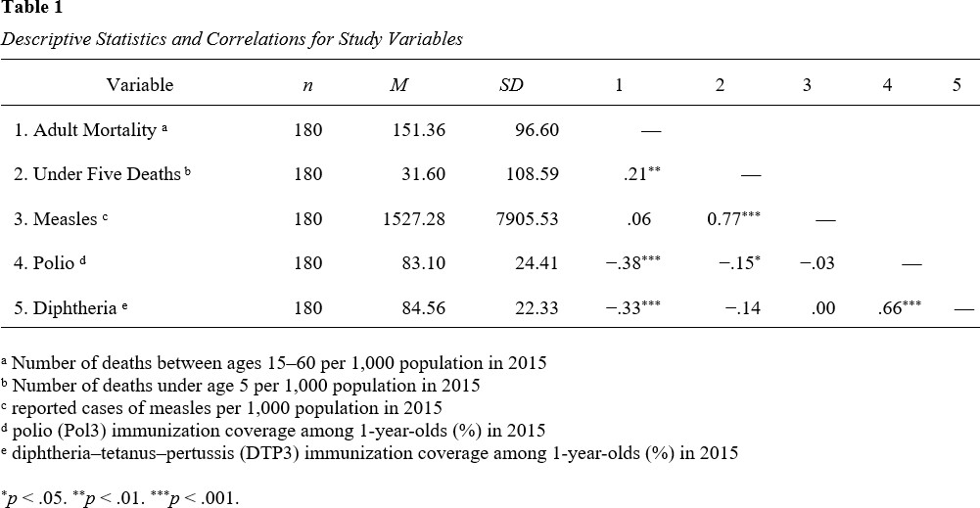
APA Format Reporting of Correlations
Sample Correlation Table

Slide 31
Handling missing data when computing correlations
Observed Sample
V1 | V2 | V3
5 | NA | 9
3 | 2 | NA
4 | 8 | 5
NA | 3 | NA
1 | 2 | 6
NA | 9 | 4
NA | 5 | NA
3 | NA | 8
2 | 6 | 5
NA | 8 | 4
There are two ways dealing with missing data when computing correlations
Listwise deletion Pairwise deletion

Slide 32
Listwise deletion: any row with a missing value is removed from data and then the correlations are computed.
Observed Sample Analytical Sample
V1 | V2 | V3
5 | NA | 9
3 | 2 | NA
4 | 8 | 5
NA | 3 | NA
1 | 2 | 6
NA | 9 | 4
NA | 5 | NA
3 | NA | 8
2 | 6 | 5
NA | 8 | 4
V1 | V2 | V3
4 | 8 | 5
1 | 2 | 6
2 | 6 | 5

Slide 33
Pairwise deletion: rows with missing data are removed per pair of variables, then the correlation is computed for each pair.
Observed Sample
Analytical Sample for V1 and V2
Analytical Sample for V1 and V3
V1 | V2 | V3
5 | NA | 9
3 | 2 | NA
4 | 8 | 5
NA | 3 | NA
1 | 2 | 6
NA | 9 | 4
NA | 5 | NA
3 | NA | 8
2 | 6 | 5
NA | 8 | 4
V1 | V2
3 | 2
4 | 8
1 | 2
2 | 6
V1 | V3
5 | 9
4 | 5
1 | 6
3 | 8
2 | 5
Analytical Sample for V2 and V3
V2 | V3
8 | 5
2 | 6
9 | 4
6 | 5
8 | 4

Slide 34
Handling Missing Data in Correlation Analysis
Listwise Deletion
Pro:
All correlations are calculated using the same complete set of cases, ensuring consistency across variable pairs.
Con:
May substantially reduce sample size, especially when multiple variables contain missing values.
This loss of data can decrease statistical power.
Pairwise Deletion
Pro:
Uses all available data for each variable pair, preserving as many observations as possible for correlation calculations, thereby minimizing data loss
Con:
Different correlations may rely on different subsets of observations, leading to inconsistency across the correlation matrix.
Results may also be biased if the missingness is not random (not MCAR).

Slide 35
Example: Life Expectancy dataset
Suppose we select the following five variables from a life expectancy dataset:
life_expectancy: life expectancy in age
bmi: average Body Mass Index of entire population
percentage_expenditure: Expenditure on health as a percentage of Gross Domestic Product per capita(%)
gdp: Gross Domestic Product per capita (in USD)
hepatitis_b: Hepatitis B (HepB) immunization coverage among 1-year-olds (%)

Slide 36
Working with cor() function
d <- read.csv(file = here('./resources/datasets/life_expectancy.csv'), header = TRUE)
d_sub <- d[,c('life_expectancy','bmi','percentage_expenditure','gdp','hepatitis_b')]
my.corr <- cor(x = d_sub) round(my.corr,2)
life_expectancy bmi percentage_expenditure gdp
life_expectancy bmi
percentage_expenditure gdp
hepatitis_b
1.00 NA
NA 1
0.04 NA
NA NA
NA NA
hepatitis_b
NA NA NA NA 1
0.04 NA
NA NA
1.00 NA
NA 1
NA NA
life_expectancy bmi
percentage_expenditure gdp
hepatitis_b

Slide 37
If your dataset contains missing values, you must specify how the cor() function should handle them when computing correlations.
Listwise deletion
my.corr <- cor(x = d_sub,
use = 'complete' )
round(my.corr,2)
 | life_expectancy | bmi | percentage_expenditure | gdp
life_expectancy | 1.00 | 0.56 | 0.06 | 0.47
bmi | 0.56 | 1.00 | 0.05 | 0.37
percentage_expenditure | 0.06 | 0.05 | 1.00 | -0.03
gdp | 0.47 | 0.37 | -0.03 | 1.00
hepatitis_b life_expectancy | 0.41 hepatitis_b 0.41 | 0.19 | 0.05 | 0.14
bmi | 0.19
percentage_expenditure | 0.05
gdp | 0.14
hepatitis_b | 1.00
However, cor() does not report the number of observations retained after listwise deletion.
To see how many observations were actually used:
nrow(na.omit(d_sub))
[1] 144
This command returns the number of complete cases in your dataset.

Slide 38
Pairwise deletion
my.corr <- cor(x = d_sub,
use = 'pairwise' )
round(my.corr,2)
 | life_expectancy | bmi | percentage_expenditure | gdp
life_expectancy | 1.00 | 0.51 | 0.04 | 0.45
bmi | 0.51 | 1.00 | 0.04 | 0.35
percentage_expenditure | 0.04 | 0.04 | 1.00 | -0.03
gdp | 0.45 | 0.35 | -0.03 | 1.00
hepatitis_b | 0.43 hepatitis_b | 0.18 | 0.04 | 0.14
life_expectancy | 0.43
bmi | 0.18
percentage_expenditure | 0.04
gdp | 0.14
hepatitis_b | 1.00
cor() does not report the number of observations used for each pair of variables.
You can write some custom code to get that information, but it requires some programming.

Slide 39
Working with rcorr() function
rcorr() function always use pairwise deletion in the presence of missing data.
my.corr <- rcorr(x | = as.matrix(d_sub))
my.corr
life_expectancy | life_expectancy bmi 1.00 0.51 |  | percentage_expenditure gdp 0.04 0.45
bmi | 0.51 1.00 |  | 0.04 0.35
percentage_expenditure | 0.04 0.04 |  | 1.00 -0.03
gdp | 0.45 0.35 |  | -0.03 1.00
hepatitis_b | 0.43 0.18 hepatitis_b |  | 0.04 0.14
life_expectancy | 0.43
bmi | 0.18
percentage_expenditure | 0.04
gdp | 0.14
hepatitis_b | 1.00
n
life_expectancy bmi percentage_expenditure gdp
life_expectancy |  | 180 178 | 180 154
bmi |  | 178 178 | 178 152
percentage_expenditure |  | 180 178 | 180 154
gdp |  | 154 152 | 154 154
hepatitis_b | hepatitis_b | 171 169 | 171 146
life_expectancy | 171
bmi | 169
percentage_expenditure | 171
gdp | 146
hepatitis_b | 171
P
life_expectancy bmi percentage_expenditure gdp
life_expectancy |  | 0.0000 0.5491 |  | 0.0000
bmi | 0.0000 | 0.6256 |  | 0.0000
percentage_expenditure | 0.5491 | 0.6256 |  | 0.7045
gdp | 0.0000 | 0.0000 0.7045
hepatitis_b | 0.0000 | 0.0167 0.5890 |  | 0.0871
life_expectancy | hepatitis_b 0.0000
bmi | 0.0167
percentage_expenditure gdp | 0.5890 0.0871
hepatitis_b

